Slide 1
Generative AI with Diffusion Models
Part 2: Denoising Diffusion Probabilistic Models

Slide 2
Agenda
• | Part 1: From U-Nets to Diffusion
• | Part 2: Denoising Diffusion Probabilistic Models
• | Part 3: Optimizations
• | Part 4: Classifier-Free Diffusion Guidance
• | Part 5: CLIP
• | Part 6: Wrap-up & Assessment
Notes:
In the previous lab, we tried using a U-Net to generate a recognizable image from noise. The model tried its best, but it wasn’t quite able to make something recognizable. We’re going to try a slightly different strategy.

Slide 3
Diffusion Inspiration
Notes:
Diffusion models are inspired from the real-life physical phenomenon of diffusion.

Slide 4
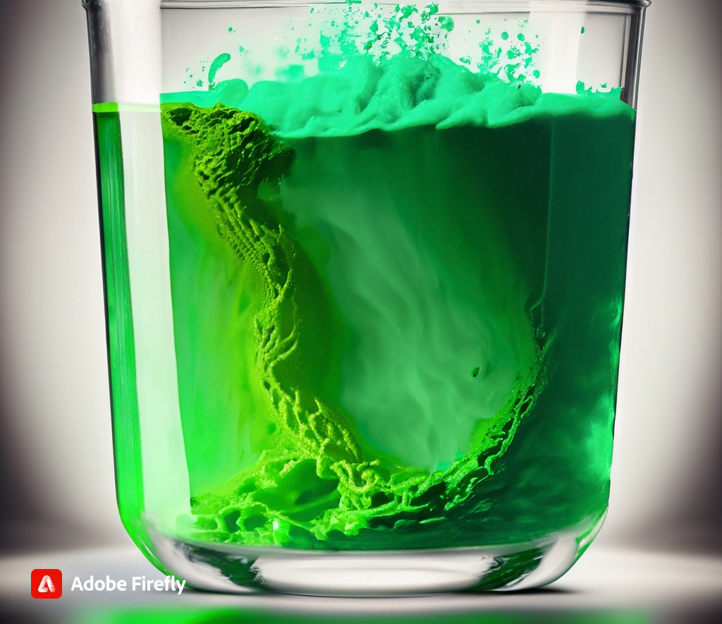
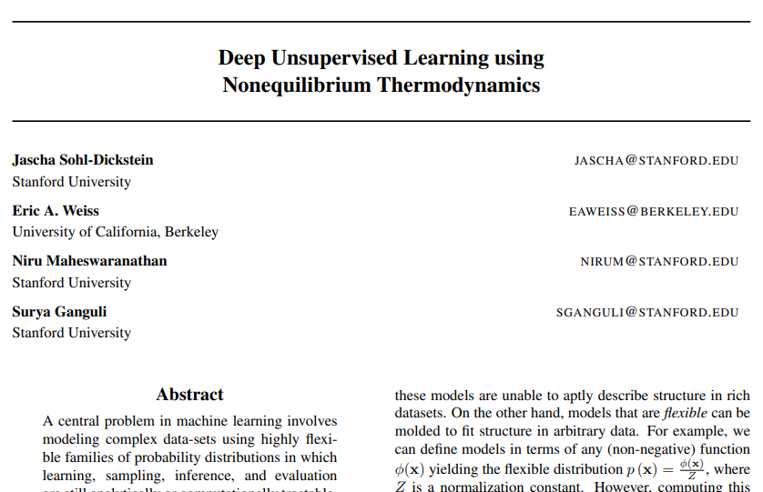
Thermodynamic Origins
Green food coloring dissolving in a glass of water
Notes:
Have you ever added a drop of food coloring to a glass of water? The color starts out concentrated and then expands and fades until eventually, there is an even mix throughout the glass. Researchers at Stanford and Berkely attempted to model this phenomenon with a neural network.
https://arxiv.org/pdf/1503.03585.pdf

Slide 5
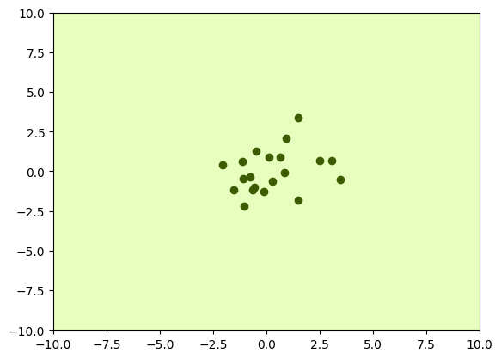
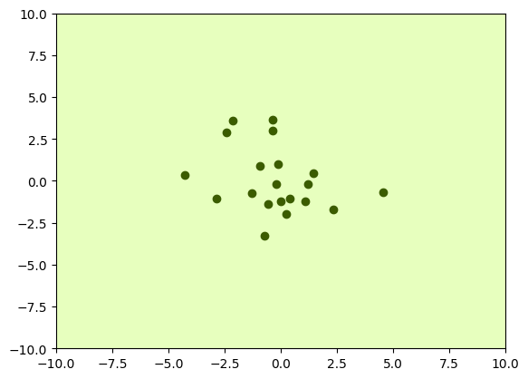
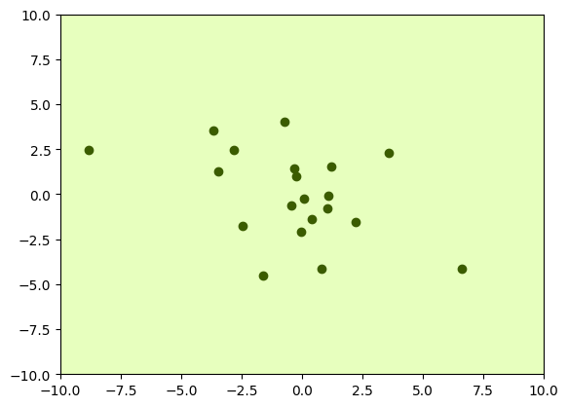
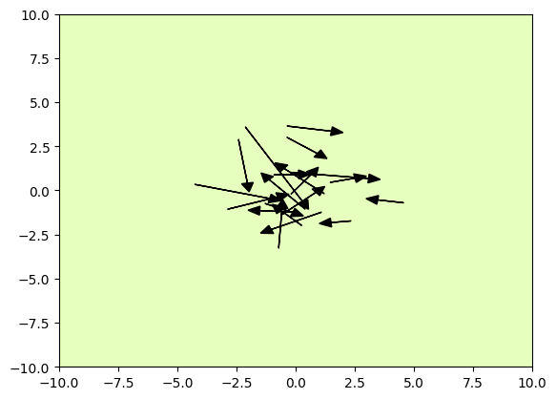
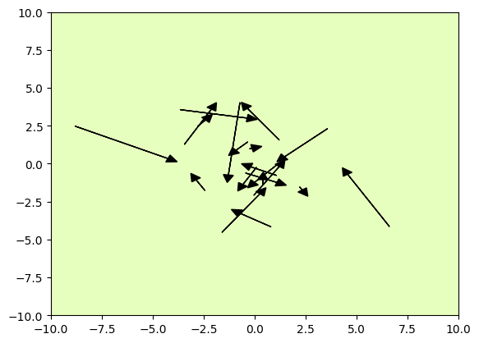
Thermodynamic Origins
t = 25
t = 75
t = 150
Notes:
Here’s how we might model the drop of food coloring. Let’s say we measure timesteps with the variable t. When t is small, the particles are clumped together. The clump expands as t increases. We could create a neural network to predict the movement of each particle between each timestep.

Slide 6
Denoising Diffusion
Probabilistic Models
Notes:
But that’s not what we’re actually going to do. We’re going to do something that’s hopefully a little more simple.
If I had to pick a theme for today, it’s that the mathematics of Diffusion can seem complex, but in practice, we’re finding that simpler approaches often give better results. So it’s ok if the math seems a little overwhelming at first. Play around with the code in the labs, see what the results are, and the intention behind these math equations will become more clear.

Slide 7
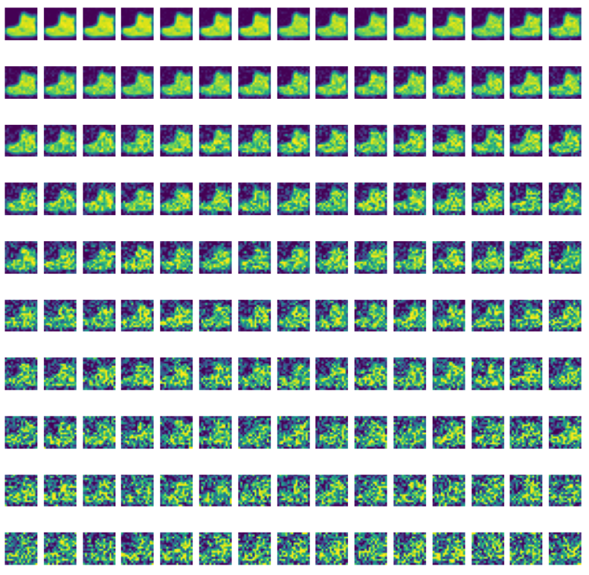
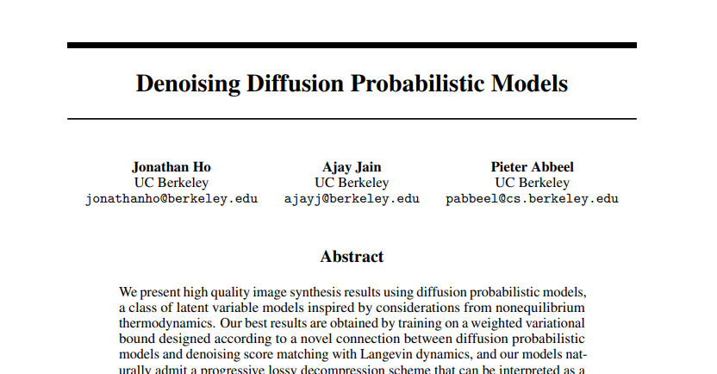
Getting Lost in the Noise
Notes:
Instead of tracking the movement of particles, we’re going to be adding noise to our fashionMNIST images. In the previous lab, we only added noise to the images once. This time, we’re going to add noise over multiple timesteps. Even though it’s only going to be a little noise each time, eventually the image will look like pure noise.
https://arxiv.org/pdf/2006.11239.pdf

Slide 8
Forward Diffusion
Notes:
We’re going to call the process of adding noise to our image the forward diffusion process.

Slide 9











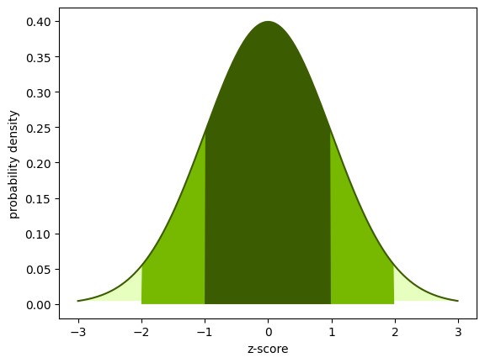

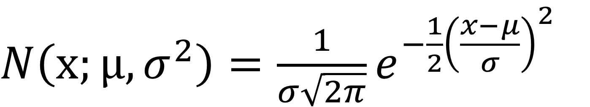
Getting Lost in the Noise
Forward Diffusion
t = 0
t = 1
t = 2
t = 3
t = 4
t = 5
t = 6
t = 7
t = 8
t = 9
t = 10
$N\left(x;μ,σ^{2}\right)=\frac{1}{σ\sqrt{2π}}e^{−\frac{1}{2}{\left(\frac{x−μ}{σ}\right)}^{2}}$
Notes:
To generate the noise, each color channel for each pixel will have a random value selected by a normal distribution like in the previous lab.

Slide 10
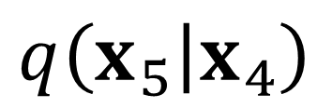

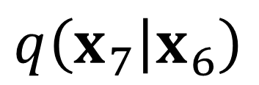
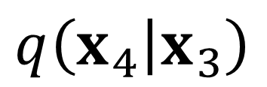
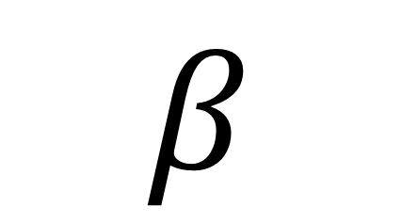
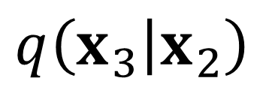
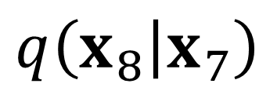
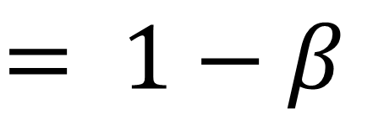
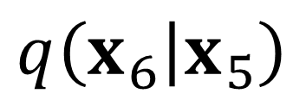
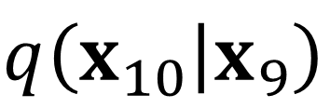
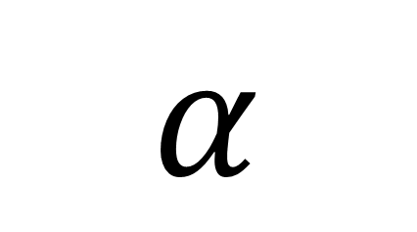
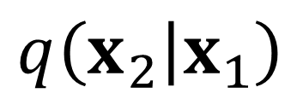
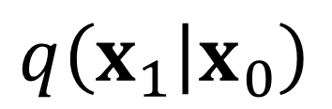
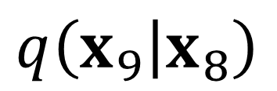
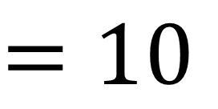
Getting Lost in the Noise
Forward Diffusion
$$q\left(\left.x_{1}\right|x_{0}\right)$$
$$q\left(\left.x_{2}\right|x_{1}\right)$$
$$q\left(\left.x_{3}\right|x_{2}\right)$$
$$q\left(\left.x_{4}\right|x_{3}\right)$$
$$q\left(\left.x_{5}\right|x_{4}\right)$$
$$q\left(\left.x_{6}\right|x_{5}\right)$$
$$q\left(\left.x_{7}\right|x_{6}\right)$$
$$q\left(\left.x_{8}\right|x_{7}\right)$$
$$q\left(\left.x_{9}\right|x_{8}\right)$$
$$q\left(\left.x_{10}\right|x_{9}\right)$$
t = 0
t = 1
t = 2
t = 3
t = 4
t = 5
t = 6
t = 7
t = 8
t = 9
t = 10
$$β$$
$$= \left[0.0001, 0.0023, 0.0045, 0.0067, …, 0.0200\right]$$
t = 0
t = 1
t = 3
t = 4
t = 10
$$T$$
$$=10$$
Total number of timesteps
$$α$$
$$= 1−β$$
Convenient shorthand
Notes:
We’re going to call the probability distribution we use to generate a noisy image at each timestep “q”. Given an image x_t, all the possible pixel values for x_t+1 will follow a normal distribution.
How much noise we add at each timestep is called the “Beta schedule” or “Variance Schedule”.
The “variance schedule” is something we decide. There is an art to it. We should add just enough for the model to tell that a change occurred. If we add to much at once, the model will have a harder time seeing a path to a recognizable destination, just like in the previous lab.
A popular “variance schedule” is to start with a small amount of noise at the beginning so the model can better generate detail, and then add larger amounts of noise later.

Slide 11
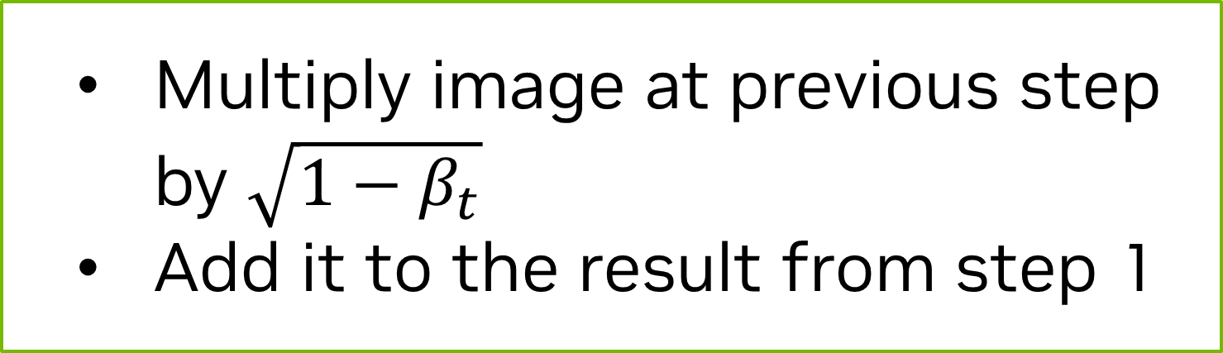
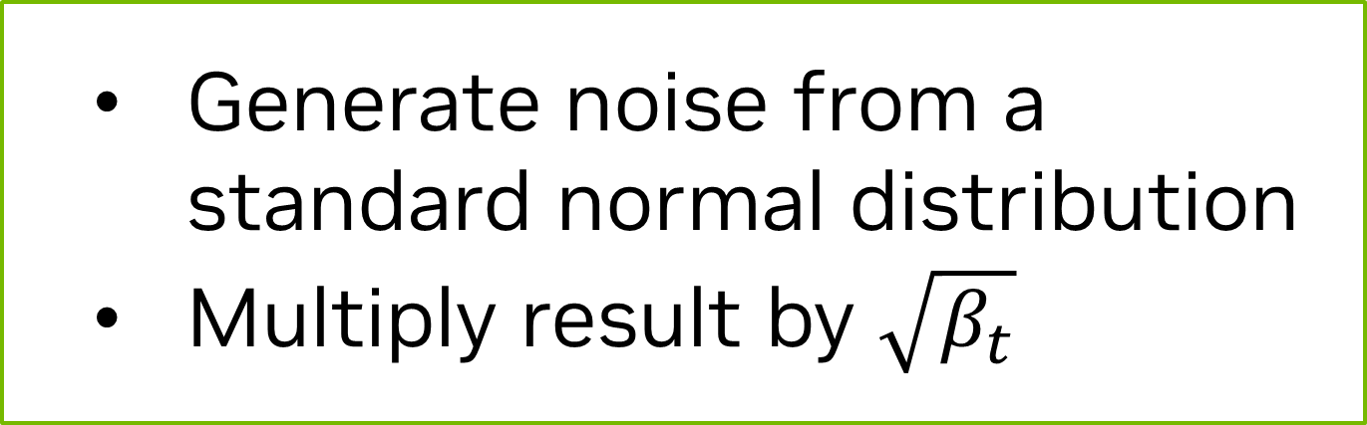
Getting Lost in the Noise
Forward Diffusion
t = 0
t = 1
t = 2
t = 3
t = 4
t = 5
t = 6
t = 7
t = 8
t = 9
t = 10
$$q\left(x_{t} | x_{t−1}\right)=N(x_{t};\sqrt{1−β_{t}}⋅x_{t−1},β_{t}⋅I)$$
Code:
Step 1:
noise = torch.randn_like(x_t)
x_t = torch.sqrt(1 - B[t]) * x_t + torch.sqrt(B[t]) * noise
Generate noise from a standard normal distribution
Multiply result by $\sqrt{β_{t}}$
Step 2:
Multiply image at previous step by $\sqrt{1−β_{t}}$
Add it to the result from step 1
Notes:
Here is the q probability distribution. The mu or average of the distribution will be the square root of 1 – Beta t multiplied by the corresponding pixel value of the various timestep. The variance, which is the standard deviation, will be Beta t. Hence the name, Variance Schedule.
The code looks less intense than the math equations. We’ll use the same function we used in the previous lab to generate noise by sampling from a standard normal distribution. Then, we’ll multiply the result of that by the square root of Beta t. Then we’ll multiply the value of each pixel in the image we want to modify by the square root of one minus Beta t. Finally, we add the modified image and the generated noise to create a new noisier image for the next timestep.
https://arxiv.org/pdf/1503.03585.pdf

Slide 12
Reverse Diffusion

Slide 13
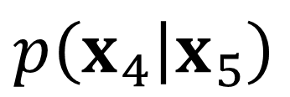
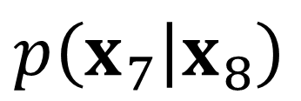
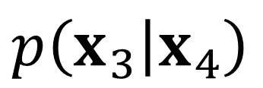

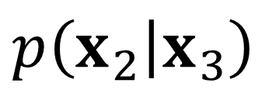
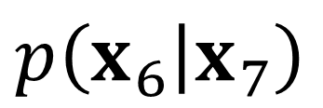
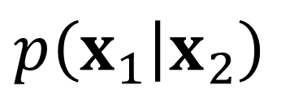
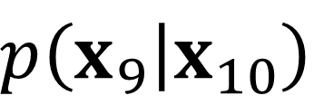
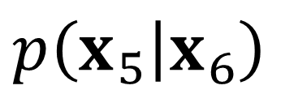
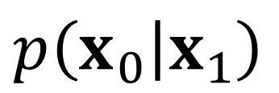
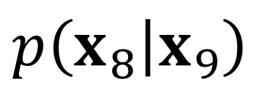
Getting Lost in the Noise
Reverse Diffusion
$$q\left(\left.x_{1}\right|x_{0}\right)$$
$$q\left(\left.x_{2}\right|x_{1}\right)$$
$$q\left(\left.x_{3}\right|x_{2}\right)$$
$$q\left(\left.x_{4}\right|x_{3}\right)$$
$$q\left(\left.x_{5}\right|x_{4}\right)$$
$$q\left(\left.x_{6}\right|x_{5}\right)$$
$$q\left(\left.x_{7}\right|x_{6}\right)$$
$$q\left(\left.x_{8}\right|x_{7}\right)$$
$$q\left(\left.x_{9}\right|x_{8}\right)$$
$$q\left(\left.x_{10}\right|x_{9}\right)$$
t = 0
t = 1
t = 2
t = 3
t = 4
t = 5
t = 6
t = 7
t = 8
t = 9
t = 10
$$p\left(\left.x_{0}\right|x_{1}\right)$$
$$p\left(\left.x_{1}\right|x_{2}\right)$$
$$p\left(\left.x_{2}\right|x_{3}\right)$$
$$p\left(\left.x_{3}\right|x_{4}\right)$$
$$p\left(\left.x_{4}\right|x_{5}\right)$$
$$p\left(\left.x_{5}\right|x_{6}\right)$$
$$p\left(\left.x_{6}\right|x_{7}\right)$$
$$p\left(\left.x_{7}\right|x_{8}\right)$$
$$p\left(\left.x_{8}\right|x_{9}\right)$$
$$p\left(\left.x_{9}\right|x_{10}\right)$$
$$p\left(x_{t−1} | x_{t}\right)=N(x_{t−1};μ_{θ}\left(x_{t},t\right),Σ_{θ}\left(x_{t},t\right))$$
Difficult to calculate
Approximate average used to create $x_{t}$
Notes:
Ok, so now we have a way to add noise to our images, but we’ll need to be able to remove noise if we want to generate images. Let’s call this hypothetical distribution p.
There are practically infinite ways noise can be added at timestep t. ut represents what the average image would be at timestep t-1. $Σ_{θ}$ represents some model of noise at the previous timestep. The trouble is… it’s challenging to know what that model is exactly. This is what our neural network will attempt to emulate.

Slide 14
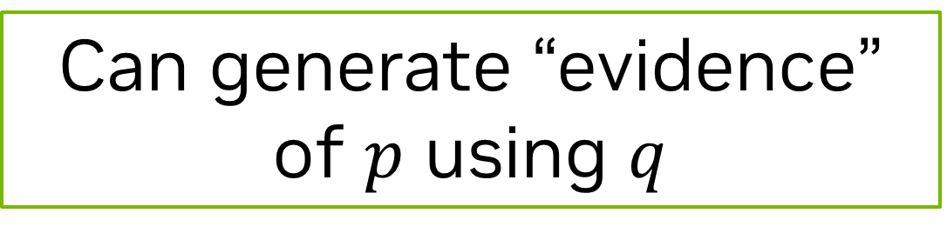
Getting Lost in the Noise
Reverse Diffusion
t = 0
t = 1
t = 2
t = 3
t = 4
t = 5
t = 6
t = 7
t = 8
t = 9
t = 10
Can generate “evidence” of $p$ using $q$
Notes:
We may not know what this p distribution is, but we know it exists. Whenever we use the q distribution to add noise to an image at time t to create a noisy image at time t+1, the image at time t is a sample of the p distribution. We will call the original image at time t “evidence” that p exists.

Slide 15

Getting Lost in the Noise
Reverse Diffusion
$$q\left(\left.x_{1}\right|x_{0}\right)$$
$$q\left(\left.x_{2}\right|x_{1}\right)$$
$$q\left(\left.x_{3}\right|x_{2}\right)$$
$$q\left(\left.x_{4}\right|x_{3}\right)$$
$$q\left(\left.x_{5}\right|x_{4}\right)$$
$$q\left(\left.x_{6}\right|x_{5}\right)$$
$$q\left(\left.x_{7}\right|x_{6}\right)$$
$$q\left(\left.x_{8}\right|x_{7}\right)$$
$$q\left(\left.x_{9}\right|x_{8}\right)$$
$$q\left(\left.x_{10}\right|x_{9}\right)$$
t = 0
t = 1
t = 2
t = 3
t = 4
t = 5
t = 6
t = 7
t = 8
t = 9
t = 10
$$p\left(\left.x_{0}\right|x_{1}\right)$$
$$p\left(\left.x_{1}\right|x_{2}\right)$$
$$p\left(\left.x_{2}\right|x_{3}\right)$$
$$p\left(\left.x_{3}\right|x_{4}\right)$$
$$p\left(\left.x_{4}\right|x_{5}\right)$$
$$p\left(\left.x_{5}\right|x_{6}\right)$$
$$p\left(\left.x_{6}\right|x_{7}\right)$$
$$p\left(\left.x_{7}\right|x_{8}\right)$$
$$p\left(\left.x_{8}\right|x_{9}\right)$$
$$p\left(\left.x_{9}\right|x_{10}\right)$$
$$p\left(x_{t−1} | x_{t}\right)=N(x_{t−1};μ_{θ}\left(x_{t},t\right),Σ_{θ}\left(x_{t},t\right))$$
$$\tilde{β_{t}}= \frac{1−{\overline{α}}_{t−1}}{1−{\overline{α}}_{t}}β_{t}$$
$$q\left(x_{t−1} | x_{t},x_{0}\right)=N(x_{t−1};\tilde{μ}\left(x_{t},x_{0}\right),\tilde{β_{t}}⋅I)$$
Use Bayes' Rule and …
Notes:
What we can do, is try to reverse the q distribution. Since we know exactly what this distribution, we can create an estimate for x_t-1 from x_t and x_0. IF you’re curious to how we arrived at this equation here, Lilian Weng has an excellent blog post on the derivation of the math.
Using Bayer’s Rule and some other mathematical tricks …
https://lilianweng.github.io/posts/2021-07-11-diffusion-models/#forward-diffusion-process

Slide 16
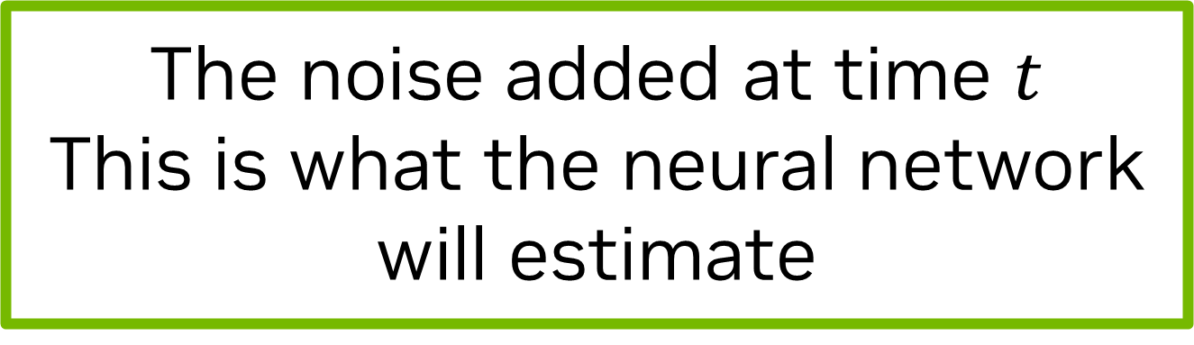

Getting Lost in the Noise
Reverse Diffusion
$$q\left(\left.x_{1}\right|x_{0}\right)$$
$$q\left(\left.x_{2}\right|x_{1}\right)$$
$$q\left(\left.x_{3}\right|x_{2}\right)$$
$$q\left(\left.x_{4}\right|x_{3}\right)$$
$$q\left(\left.x_{5}\right|x_{4}\right)$$
$$q\left(\left.x_{6}\right|x_{5}\right)$$
$$q\left(\left.x_{7}\right|x_{6}\right)$$
$$q\left(\left.x_{8}\right|x_{7}\right)$$
$$q\left(\left.x_{9}\right|x_{8}\right)$$
$$q\left(\left.x_{10}\right|x_{9}\right)$$
t = 0
t = 1
t = 2
t = 3
t = 4
t = 5
t = 6
t = 7
t = 8
t = 9
t = 10
$$p\left(\left.x_{0}\right|x_{1}\right)$$
$$p\left(\left.x_{1}\right|x_{2}\right)$$
$$p\left(\left.x_{2}\right|x_{3}\right)$$
$$p\left(\left.x_{3}\right|x_{4}\right)$$
$$p\left(\left.x_{4}\right|x_{5}\right)$$
$$p\left(\left.x_{5}\right|x_{6}\right)$$
$$p\left(\left.x_{6}\right|x_{7}\right)$$
$$p\left(\left.x_{7}\right|x_{8}\right)$$
$$p\left(\left.x_{8}\right|x_{9}\right)$$
$$p\left(\left.x_{9}\right|x_{10}\right)$$
$$p\left(x_{t−1} | x_{t}\right)=N(x_{t−1};μ_{θ}\left(x_{t},t\right),Σ_{θ}\left(x_{t},t\right))$$
$$q\left(x_{t−1} | x_{t},x_{0}\right)=N(x_{t−1};\tilde{μ}\left(x_{t},x_{0}\right),\tilde{β_{t}}⋅I)$$
$$\tilde{μ_{t}}=\frac{1}{\sqrt{α_{t}}}\left(x_{t}−\frac{1−α_{t}}{\sqrt{1−α_{t}}}ε_{t}\right)$$
The noise added at time $t$
This is what the neural network will estimate
Notes:
We can create an estimate for what the average image at timestep t would look like. We know our neural network is decent at recognizing added noise, which is $ε_{t}$ in this equation. We will use our network to predict the noise, plug in our values of alpha, and this will help us predict what an image at the previous timestep could look like.
Then, we can start from pure noise, and use this function repeatedly to generate an unseen image!

Slide 17
Model Training
Notes:
Congratulations if you got this far. That was the most intense mathematics will be doing today. It’s all downhill from here.
Now that we know the theory, let’s see how this changes our neural network.

Slide 18
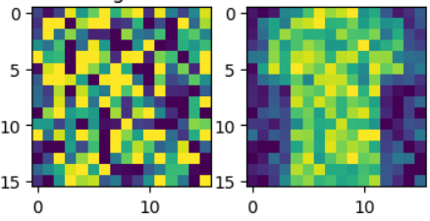
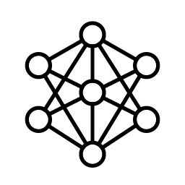
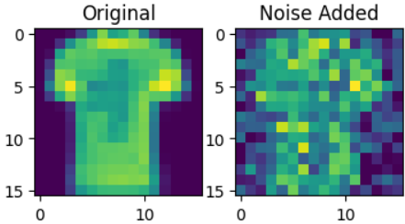
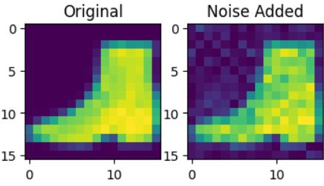
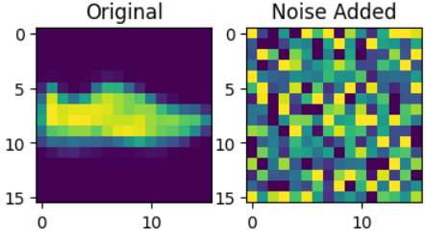
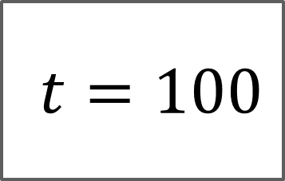



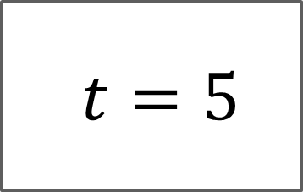
Model Training
Training Data
Noisy image at time $t$
Noise added at time $t$
$$q\left(x_{t} | x_{0}\right)=N(x_{t};\sqrt{{\overline{α}}_{t}}⋅x_{0}, \left(1−{\overline{α}}_{t}\right)⋅I)$$
“Skip ahead” function
$t=5$
$t=25$
$t=100$
Notes:
Given a noisy at time t, our model will predict what noise was added to it between t-1 and t.
Thanks to some handy properties of the normal function, we don’t have to generate a noisy image at each timestep to do this. We can use the power of recursion to predict what a noisy image at time t would like like straight from the original clean image at t = 0/

Slide 19

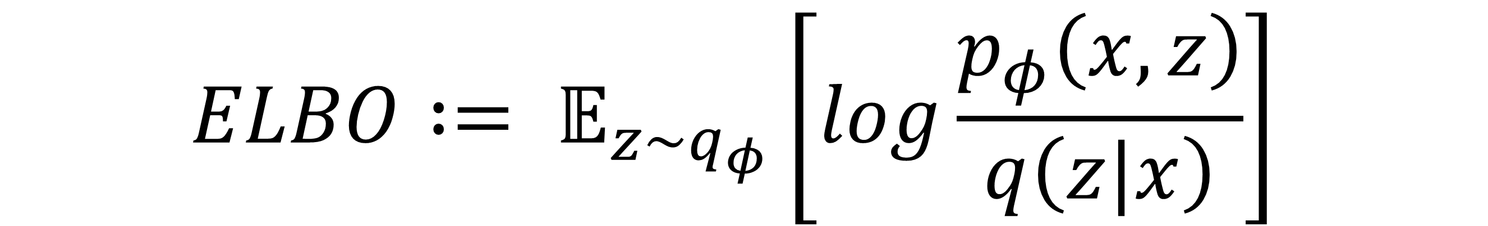
Model Training
ELBO Loss
Noisy image at time $t$
Noise added at time $t$
$$ELBO∶= 𝔼_{z\sim q_{φ}}\left[log\frac{p_{φ}\left(x, z\right)}{q\left(z|x\right)}\right]$$
$$MSE= \frac{1}{n}{\sum_{i=1}^{n}{\left(y_{i}−{\hat{y}}_{i}\right)}}^{2}$$
Notes:
Ok, ready for some more intense math?
Just kidding, we’re going to be using good ol’ fashioned mean squared error for the loss function. The loss function was originally using ELBO loss which stands for:
Evidence based
Lower Bound
Of the Log Likelihood
The likelihood is when we create a function to calculate the probability or probability density for fixed events in terms of model parameters. Let’s use an example. Let’s say I want to know what the chances are that I flip 10 heads. I could create a function to calculate that probability based on the number of coin flips, n. If the coin is weighted, I could make it a multivariate function and also base it on the probability a coin will land on heads, p.
Depending on what kind of event we’re creating this function for, it can be very challenging to create such a function, so Jensen’s inequality is used to say, “the probability is at least this.” (Johan Jensen, not NVIDIA’s Jensen).
The evidence is our evidence that p exists: each image used to generate a new noisy image.
If this is too much at once, do not worry about it. It turns out, like many things in life, a simpler approach is better in practice.

Slide 20
Model Architecture
Notes:
Now that we have our loss function, let’s see how the model architecture changes.

Slide 21
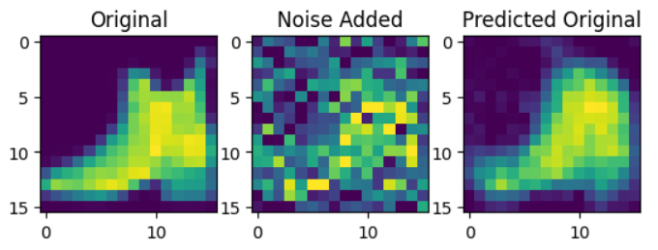


The U-Net Architecture
Previous Lab
Feature Map
(Down0)
Down0
Copy
Feature Map
(Up2)
16 px
16 px
16 px
16 px
16 px
16 px
16 px
16 px
1 ch
16 ch
2 x 16 ch
1 ch
Feature Map
(Down1)
Down1 Copy
Feature Map
(Up1)
8 px
8 px
8 px
8 px
32 ch
2 x 32 ch
Feature Map
(Down2)
4 px
Latent Vector
Down2 Copy
Feature Map
(Up0)
4 px
64 ch
4 px
2 x 64 ch
128 ch
4 px
64 x 32 x 32
1024 features
Notes:
This is what we used in the previous lab. It’s actually very similar to what we will be doing in the next lab. Let’s get rid of the dimensions to better see the connections and update the input and output.

Slide 22
The U-Net Architecture
Next Lab
Feature Map
(Down0)
Down0
Copy
Feature Map
(Up2)
Feature Map
(Down1)
Down1 Copy
Feature Map
(Up1)
Feature Map
(Down2)
Down2 Copy
Feature Map
(Up0)
Latent Vector
Notes:
Ok, one more step. Here, the architecture is the same as before, so we need to add…

Slide 23
It’s About Time
Adding Time
Time
Time Embed 2
Feature Map
(Down0)
Down0
Copy
Feature Map
(Up2)
Time Embed 1
Feature Map
(Down1)
Down1 Copy
Feature Map
(Up1)
Feature Map
(Down2)
Down2 Copy
Feature Map
(Up0)
Latent Vector
Notes:
This. This is a time embedding. Since the variance schedule changes over time, the model will perform better if it know which timestep it is removing the noise for. We’re going to be adding this embedding straight into our feature maps. Let’s take a moment to break down what that means.

Slide 24




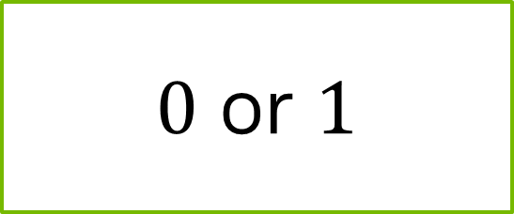
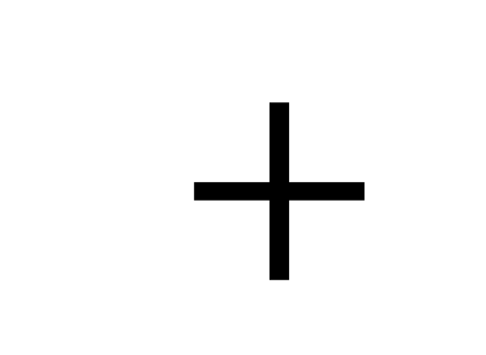

It’s About Time
Broadcasting
1 | 0 | 1
0 | 1 | 0
1 | 0 | 1
$5$
$+$
$=$
1 | 0 | 1
0 | 1 | 0
1 | 0 | 1
$5$
$0$ or $1$
$$3 x 3$$
Dimensions
Notes:
What happens when we add 5 to a matrix?
Sorry, trick question. That’s not actually possible. A scalar only has one dimension. A matrix has multiple.

Slide 25






It’s About Time
Broadcasting
1 | 0 | 1
0 | 1 | 0
1 | 0 | 1
Each dimension of 1 will repeat its element to align with destination
[[$5]]$
$+$
$$1 x 1$$
5 | 5 | 5
5 | 5 | 5
5 | 5 | 5
1 | 0 | 1
0 | 1 | 0
1 | 0 | 1
6 | 5 | 6
5 | 6 | 5
6 | 5 | 6
$+$
$=$
$$3 x 3$$
$$3 x 3$$
$$3 x 3$$
Notes:
What we can do is turn our 5 into a 1 by 1 matrix. Many matrix libraries will interpret this to mean we would like to broadcast the 5 so we can add it to the matrix. For each dimension of 1, that dimension will be repeat to fit the destination matrix. So, our 1 by 1 matrix containing 5 will become a 3 by 3 matrix of 5s.

Slide 26

It’s About Time
Broadcasting
1
2
3
1 | 0 | 1
0 | 1 | 0
1 | 0 | 1
Each dimension of 1 will repeat its element to align with destination
$+$
$$3 x 1$$
1 | 1 | 1
2 | 2 | 2
3 | 3 | 3
1 | 0 | 1
0 | 1 | 0
1 | 0 | 1
2 | 1 | 2
2 | 3 | 2
4 | 3 | 4
$+$
$=$
$$3 x 3$$
$$3 x 3$$
$$3 x 3$$
Notes:
Let’s look at a more complicated example. Our time embedding is a vector, meaning it’s a matrix where all but one dimensions have a size of 1. In this case, we have a 3 by 1 vector. We can add it to our 3 by 3 matrix because each respective dimension is either the same size or 1. So, the 3 by 1 vector becomes a 3 by 3 matrix by repeating the vector values 3 times.

Slide 27
Let’s get started!
Notes:
It takes some practice to get used to it, so let’s start practicing!

